Slide 1

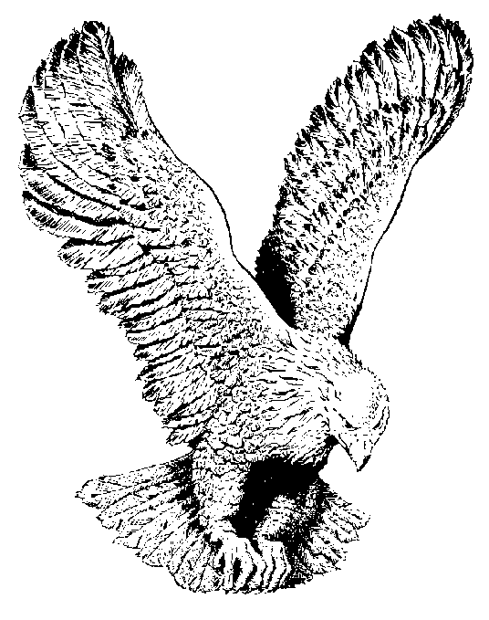
664 THE WATERS OF PEACE
Beside the still waters in pastures of green,
The Shepherd is leading where all is serene,
By day and by night He will always be seen,
Beside the still waters of Peace.

Slide 2
Beside the still waters the sheep find their rest
The Shepherd stands by so that none can molest,
The flock by His presence is happy and blessed,
Beside the still waters of Peace.

Slide 3
The sheep know His voice and they go not astray,
For Jesus will guide all the way,
In paths that are righteous, He leads day by day,
Beside the still waters of Peace.

